Slide 1
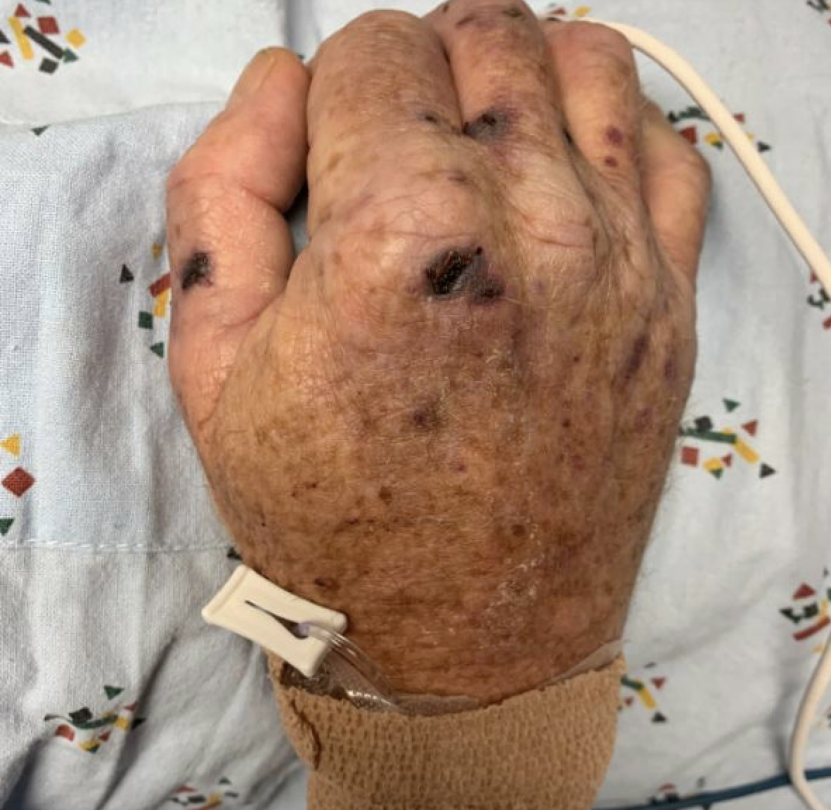
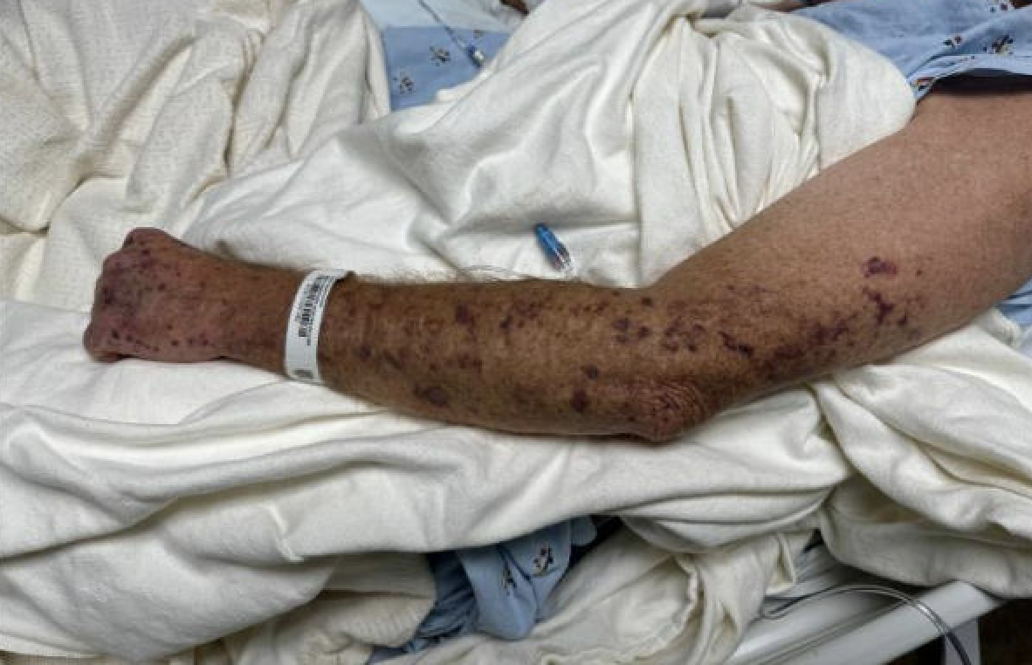
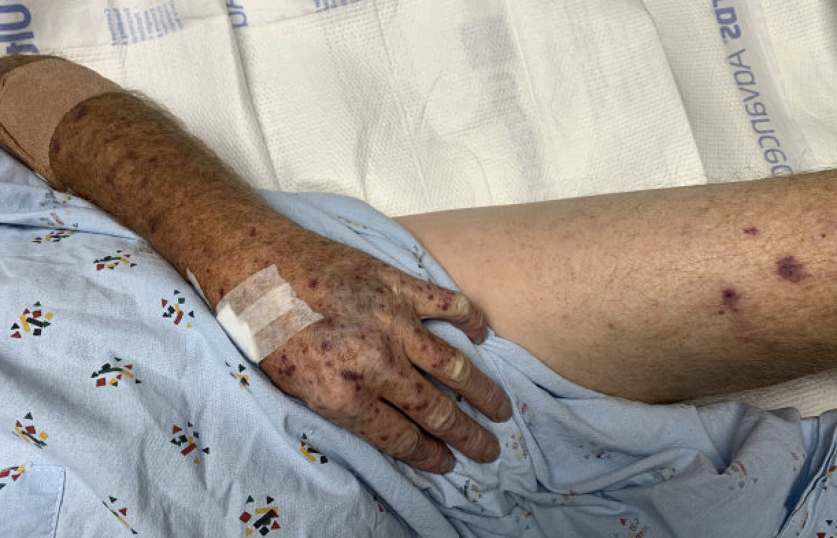
Shirley P. Parraga, BS¹, Wasim A. Haidari, MD¹, Christine S. Ahn, MD¹, Steven R. Feldman, MD, PhD^{1, 2, 3,}, Lindsay C. Strowd ¹ ¹ Center for Dermatology Research, Department of Dermatology, Wake Forest University School of Medicine, Winston-Salem, North Carolina ² Department of Pathology, Wake Forest University School of Medicine, Winston-Salem, North Carolina, ³ Department of Social Sciences & Healthy Policy, Wake Forest University School of Medicine, Winston-Salem, North Carolina
Capnocytophaga canimorsus-associated wound complications in humans after dog bites: a case series
Introduction
Capnocytophaga canimorsus (C. canimorsus) is a gram-negative bacterium that is a part of the commensal oral flora of dogs and cats.
It is recognized as an etiological factor of wound infections in humans leading to multiple complications including septic shock after exposure to a dog bite.
Risk factors for C. canimorsus infection include asplenia, immunosuppression, cirrhosis, and alcohol use disorder.
Methods
Records of the inpatient dermatology service in a single-center hospital in North Carolina from 2018-2022 were reviewed.
Three cases of C. canimorsus infection were identified.
Patient characteristics and clinical presentations were analyzed.
Results
Three cases of C. canimorsus infection presenting with rapid evolution of sepsis accompanied by fevers, hypotension, altered mental status, and disseminated purpuric lesions were identified.
Patients’ ages varied from 56 to 74.
Two patients had a recent dog bite while one patient had a catch scratch exposure.
Other risk factors included history of splenectomy (n=2), liver cirrhosis (n=1), and alcohol use disorder (n=1).
Skin biopsies in all three cases revealed occlusive vasculopathy with a negative direct immunofluorescence.
On laboratory evaluation, patients had disseminated intravascular coagulation (3), elevated lactate (3), acute kidney injury (3), and transaminitis (2).
Diagnosis was established via blood cultures, which isolated C. canimorsus.
All three patients improved after treatment with appropriate antibiotics.
Figure 1. Site of dog bite on Patient A’s right hand.
Figure 2. Disseminated purpuric lesions on Patient A’s left upper extremity.
Figure 3. Disseminated purpuric lesions on Patient A’s left upper and lower extremities.
Conclusion
Capnocytophaga species is not routinely screened in the United States.
Maintaining a high index of suspicion in patients with risk factors, sepsis of unknown etiology, and purpuric skin eruption may help with earlier diagnosis and appropriate treatment.
Fatal progression of C. canimorsus infection may be avoided with prompt antibiotic therapy, particularly, in patients with coexisting risk factors.
References
Butler T. Capnocytophaga canimorsus: an emerging cause of sepsis, meningitis, and post-splenectomy infection after dog bites. Eur J Clin Microbiol Infect Dis. 2015;34(7):1271-1280. doi:10.1007/s10096-015-2360-7
Goldberg, M.B. (2021) Capnocytophaga, UpToDate. Available at: https://www.uptodate.com/contents/capnocytophaga. Accessed: 01 September 2023.
Hannon DM, Harkin E, Donnachie K, Sibartie S, Doyle M, Chan G. A case of Capnocytophaga canimorsus meningitis and bacteraemia. Ir J Med Sci. 2020;189(1):251-252. doi:10.1007/s11845-019-02045-0
Ma A, Goetz MB. Capnocytophaga canimorsus sepsis with associated thrombotic thrombocytopenic purpura. Am J Med Sci. 2013;345(1):78-80. doi:10.1097/MAJ.0b013e318262db1a
van Samkar A, Brouwer MC, Schultsz C, van der Ende A, van de Beek D. Capnocytophaga canimorsus Meningitis: Three Cases and a Review of the Literature. Zoonoses Public Health. 2016;63(6):442-448. doi:10.1111/zph.12248
Vignon G, Combeau P, Violette J, et al. A fatal septic shock due to Capnocytophaga canimorsus and review of literature. Rev Med Interne. 2018;39(10):820-823. doi:10.1016/j.revmed.2018.03.384
Zajkowska J, Król M, Falkowski D, Syed N, Kamieńska A. Capnocytophaga canimorsus – an underestimated danger after dog or cat bite – review of literature. Przegl Epidemiol. 2016;70(2):289-295.
Acknowledgements
We’d like to thank Atrium Health Wake Forest Baptist for their support.

