Slide 1

Combined
Internal Medicine-Dermatology
Residency Training Program
Joseph F. Merola, MD, MMSc
Associate Professor, Harvard Medical School
Associate Program Director, Combined Internal Medicine-Dermatology Residency Program
Vice Chair, Clinical Trials and Innovation
Director of Clinical Trials, Clinical Unit for Research Innovation and Trials
Director, Center for Skin and Related Musculoskeletal Diseases
Department of Dermatology and Department of Medicine, Division of Rheumatology
Brigham and Women’s Hospital

Slide 2

Overview
1. Welcome and Introductions
2. Med-Derm history / philosophy
Programmatic details
Med-Derm Research
Medicine @ BWH

Slide 3
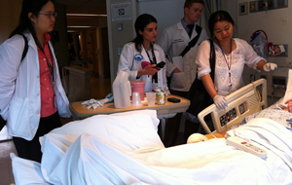
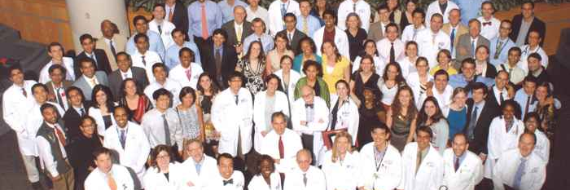
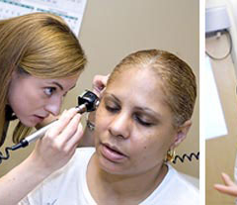
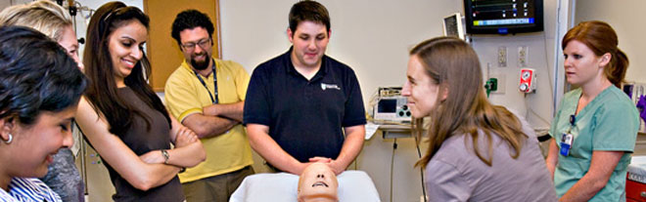
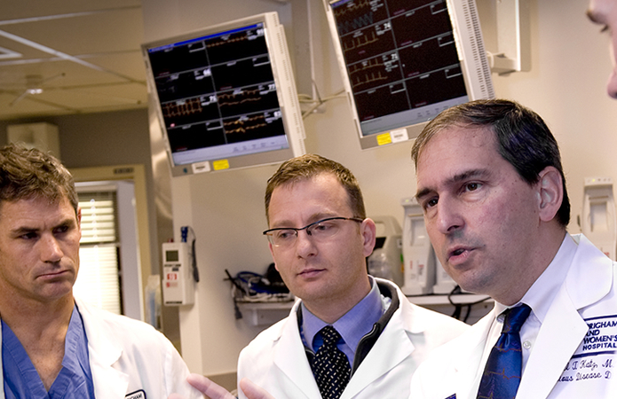
Welcome!

Slide 4
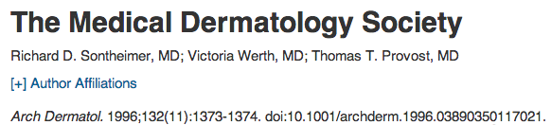


Slide 5
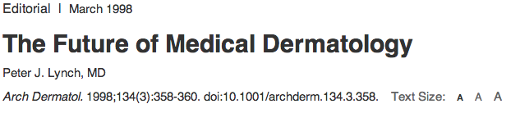

Slide 6
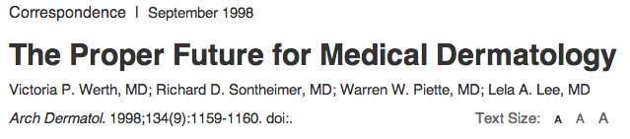
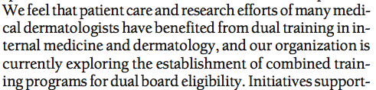

Slide 7
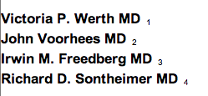


Slide 8
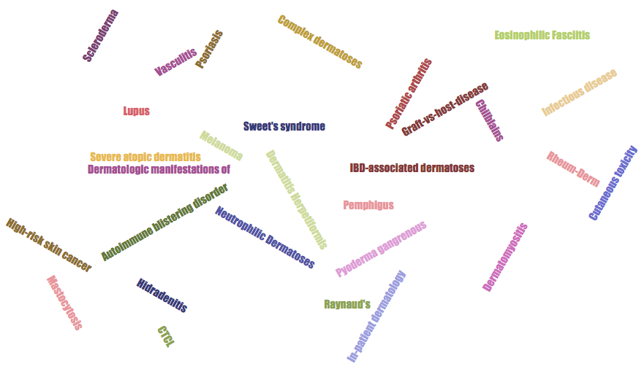



Slide 9
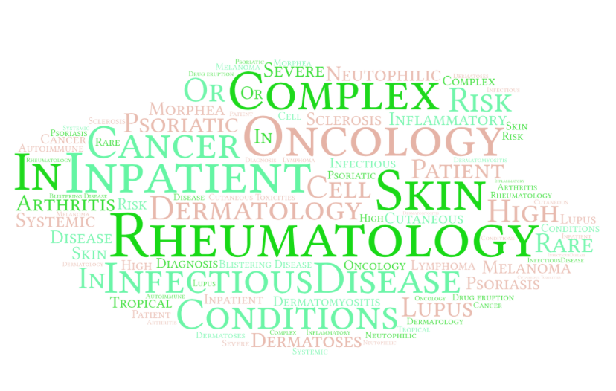

Slide 10
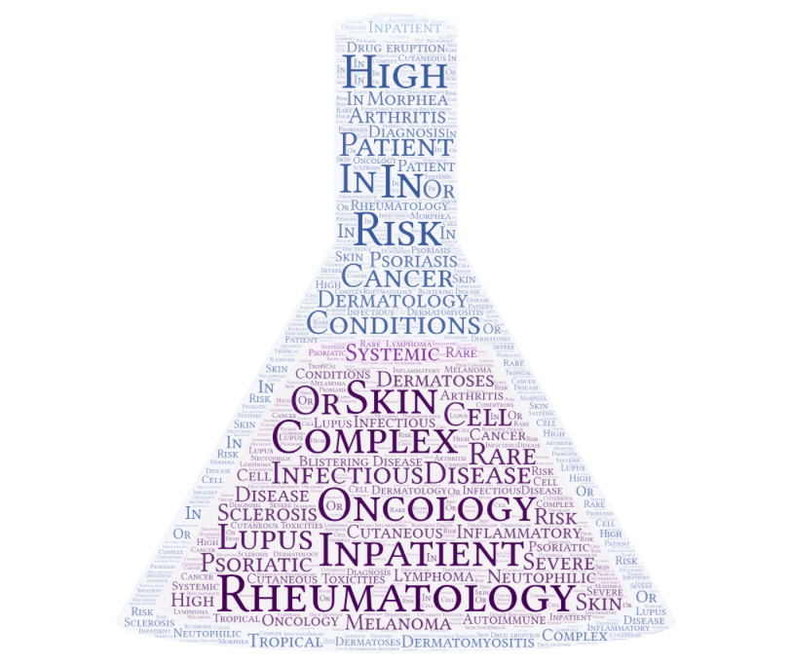

Slide 11


Slide 12


Slide 13
Goals and Objectives
Acquire knowledge and experience across both medicine and dermatology disciplines:
  To care for patients with complex medical and dermatologic illnesses
    Eg: autoimmune and blistering disorders, vasculitides, lymphomas, cutaneous malignancies, dermatologic manifestations and implications of systemic diseases
Clinical fellowship training in a wide variety of internal medicine subspecialties or dermatology fellowship programs

Slide 14

MED-DERM?

Slide 15
Med-Derm ≠ Medicine + Dermatology
?(Med-Derm ≠ CCU + Cosmetic clinic)
Reconciling requirements and ‘complete training’ with the focus of med-derm education
?(Med-Derm ≠ complex dermatology)
Distinguishing ourselves; value added (?)
?(Med-Derm ≠ an understood necessity by respective parties)
Establishing our place in the house of medicine; still nascent and not a given; fragile
= Set of unique skills, focus and challenges in training, education and patient care

Slide 16
Variable Career Goals=
Meeting individual needs
Training the med-derm
The med-derm as teacher
(direct and indirect)
Clinical
Educational
Medicine
Dermatology
Defining and
Re-defining
Training
Goals:
Individual interests vs.
Group standards
Service:Education
Unique vs. Common Training Experiences
Unique identity within two distinct programs
Critical Mass:
-Awareness / presence
-MDS vs. other supporting organization meeting
-Leadership / direction
-Mentoring
-Alumni Development
Research
(Call to action)
-demonstrating value
-advancing the field

Slide 17



Med-Derm Organizational Chart
BWH
Medicine
Harvard Combined Dermatology
PD: Joel Katz
PD: Jennifer Huang
Assoc PD: Joseph Merola
Medicine Chief
Residents
Dermatology Chief
Residents
Med-Derm Administrative Chief(s)
Med-Derm Residents

Slide 18
Sample Medicine Requirements Template
PGY | 1 | 2 | 3 | 4 | 5 | TOTALS
Vacation (med) | 4 |  | 2 | 2 | 2 | 10
IP Non-ICU | 20 |  | 8 | 6 | 12 | 46
IP ICU/CCU | 6/2 |  | 0/2 or 2/0 | 4/0 | 0 (optional) | 12-14
Ambulatory | 12 |  | 6 | 6 | 0 | 24-28
Med Consults | 0 |  | 0 | 0 | 2 | 2
ED | 2 |  | 2 | 0 | 0 | 4
Geriatrics | 2 |  | 2 | 0 | 0 | 2-4
Elective, Other |  |  |  | 2 | 4 | 12
- Rheum |  |  | 2
- Onc |  |  |  | 2
- ID |  |  |  |  | 2
Sick Call | 4 |  | 2 | 2 | 2 | 10
DERMATOLOGY
Medicine Continuity Clinic (Goal >130) | x | x | 1/2 | Optional | Optional
Dermatology Continuity Clinic |  |  | 1/2 | X | X
Med-Derm FUSION block |  |  |  |  | X

Slide 19
Medicine requirements
PGY | 1 | 2 | 3/4/5 |  |  | Target
Vacation (Med) | 4 | Dermatology Year | 2 | 2 | 2 | 10
IP Non-ICU | 20 |  |  |  |  | 46
IP ICU/CCU | 6 |  |  |  |  | 12
Ambulatory | 12 |  | 6 | 6 | 4 | 28
Med Consults | 0 |  |  |  | 2 | 2
ED | 2 |  |  |  |  | 4
Geriatrics | 0 |  |  |  |  | 2
Elective | 0 |  | 2 | 4 | 6 | 12
Sick Call | 4 |  |  |  |  | 10
 | NOTE: listed in weeks
Medicine Continuity Clinic | x | x | 1/2 | Optional | Optional
Dermatology Continuty Clinic |  |  | 1/2 | x | x

Slide 20
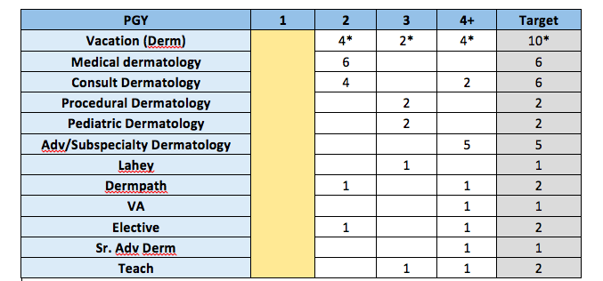
Dermatology requirements

Slide 21
Med-Derm “Fusion Blocks”
1 month from dermatology
2 months of medicine-dermatology
fusion block
1 month from internal medicine
Onc Focus
Rheum Focus
ID Focus

Slide 22
Sample Fusion Schedules
Rheum Focus
Onc Focus
ID Focus
Cristina Thomas and Emily Baumrin

Slide 23
The Future of Med-Derm is Defined by what do (our) trainees do after graduation
Med-Derm hospitalist / inpatient consultation
Complex and specialty clinics
Research (clinical >> basic)
Education
Fellowships (Rheum, Onc, Mohs…)
Administrative-Leadership roles

Slide 24
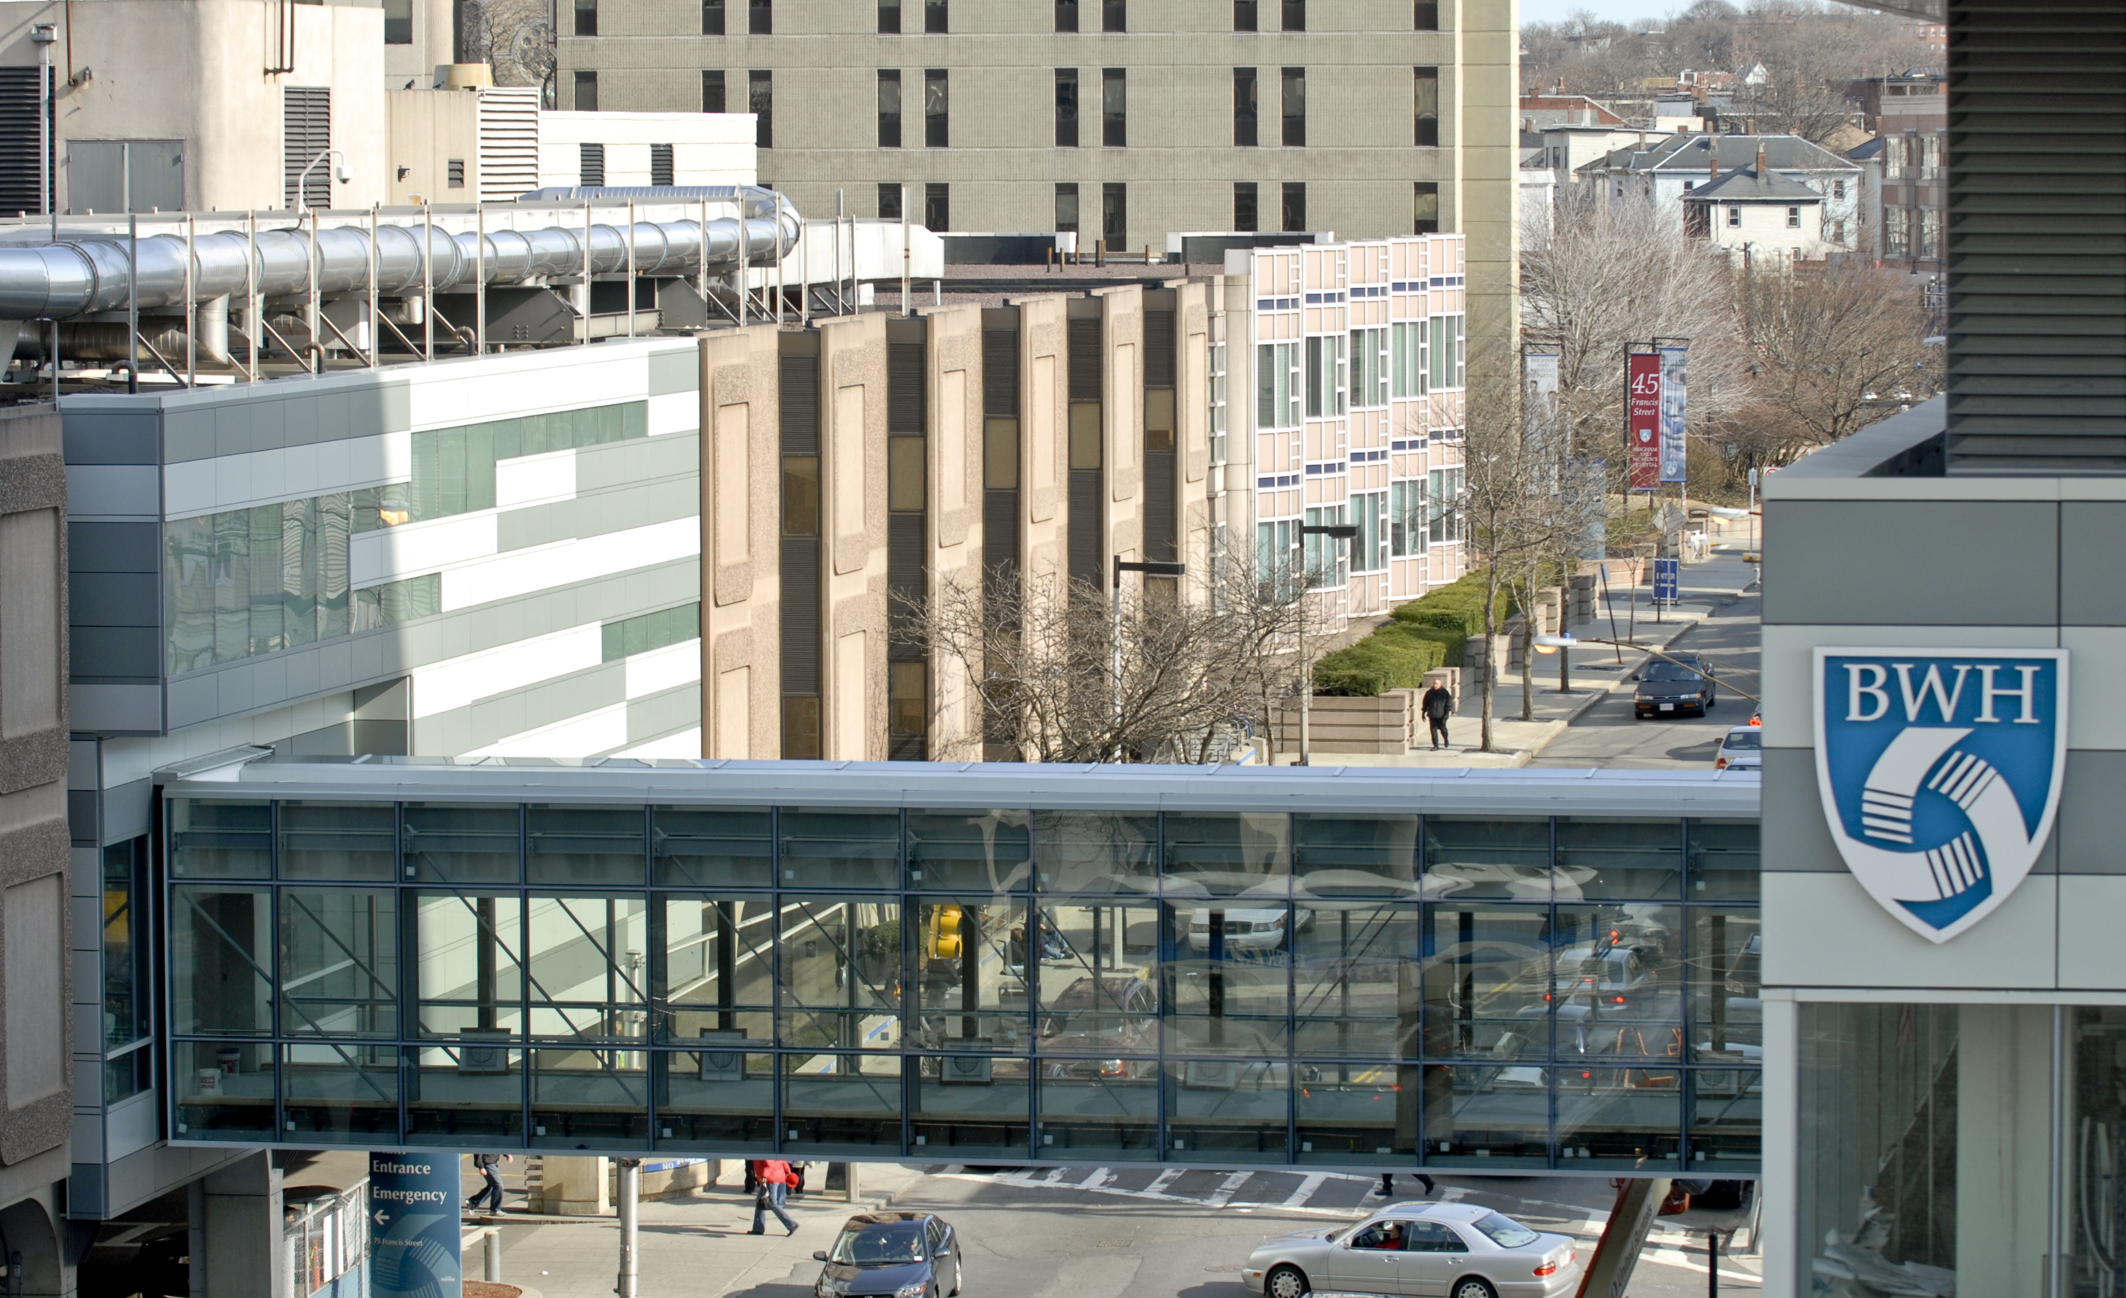
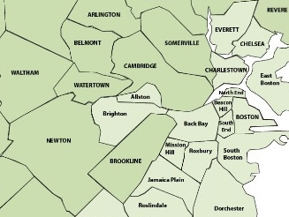
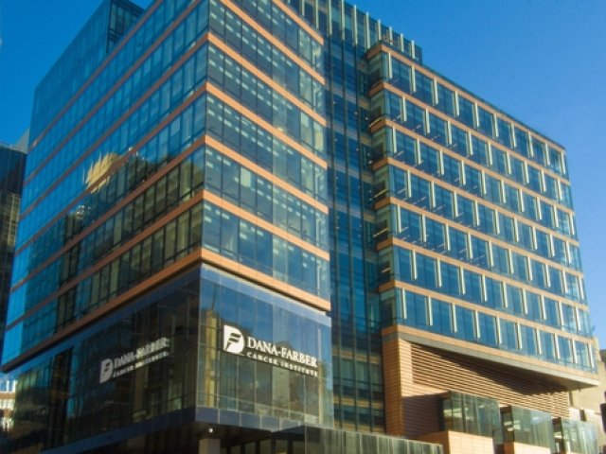
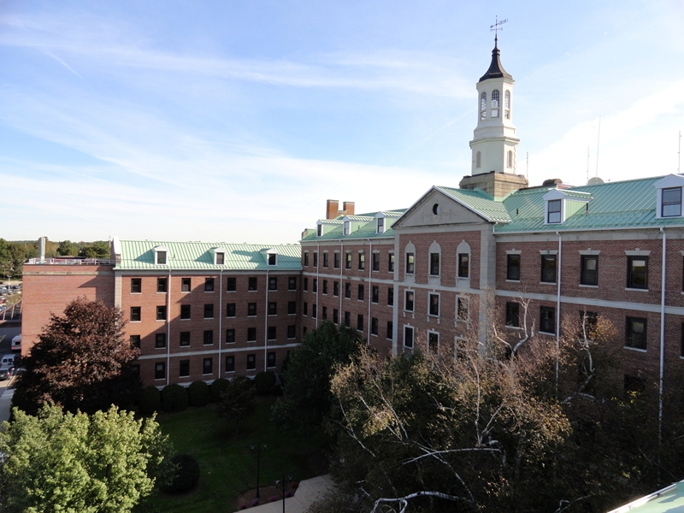
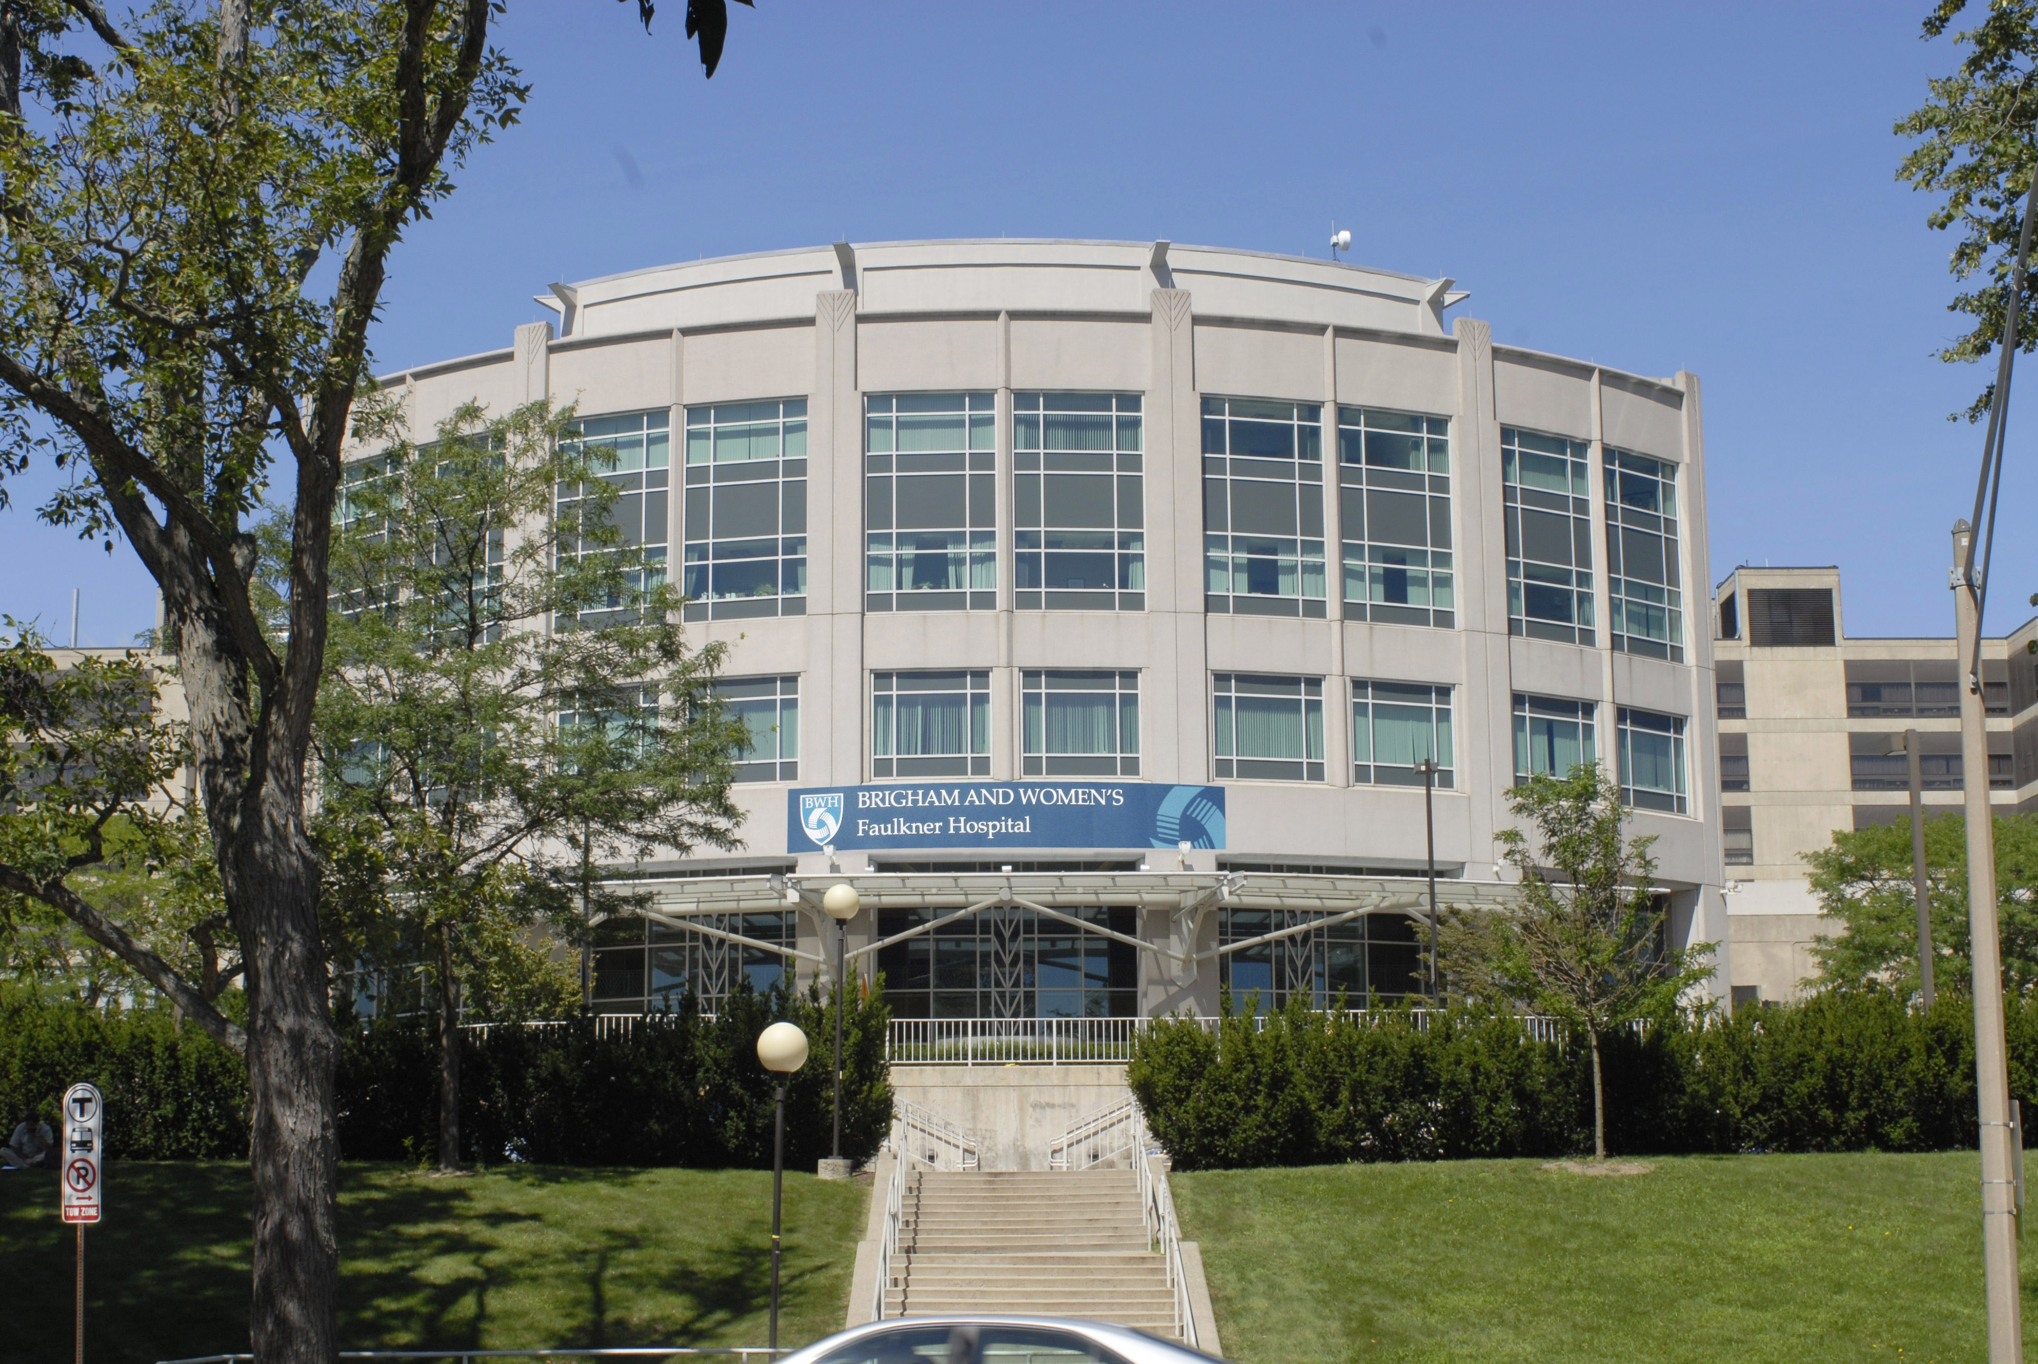
BWH Medicine
A truly special place with truly special people
Outstanding clinical education
Local environment / mix of patients; BWH, BWFH, VA
Outpatient clinics
Emphasis on mentorship / individualized experiences

Slide 25
BWH Medicine Pathways
Global Health Equity (GHE)
Management Leadership Pathway (MLP)
Adult Genetics
Science in Residency Pathway (SIR)
Clinical Investigation Pathway (CIP)
Scholars in Medical Education (SME)
Social Justice (in development)

Slide 26
Housekeeping Note
Today’s interview today will count for both Med Derm and Prelim Medicine rank lists – if you are interested in categorical medicine and have not already interviewed please let us know

Slide 27









A Wealth of Intramural and Extramural Clinical Research Resources

Slide 28
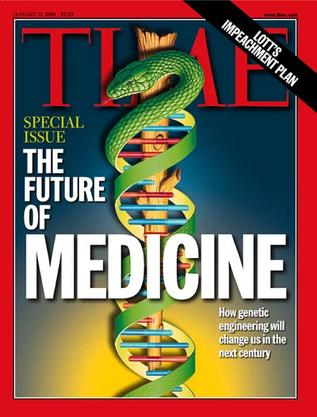
DERM
The future of med-derm is bright!...

Slide 29





Welcome!

Slide 30

Questions / Comments

